Slide 1
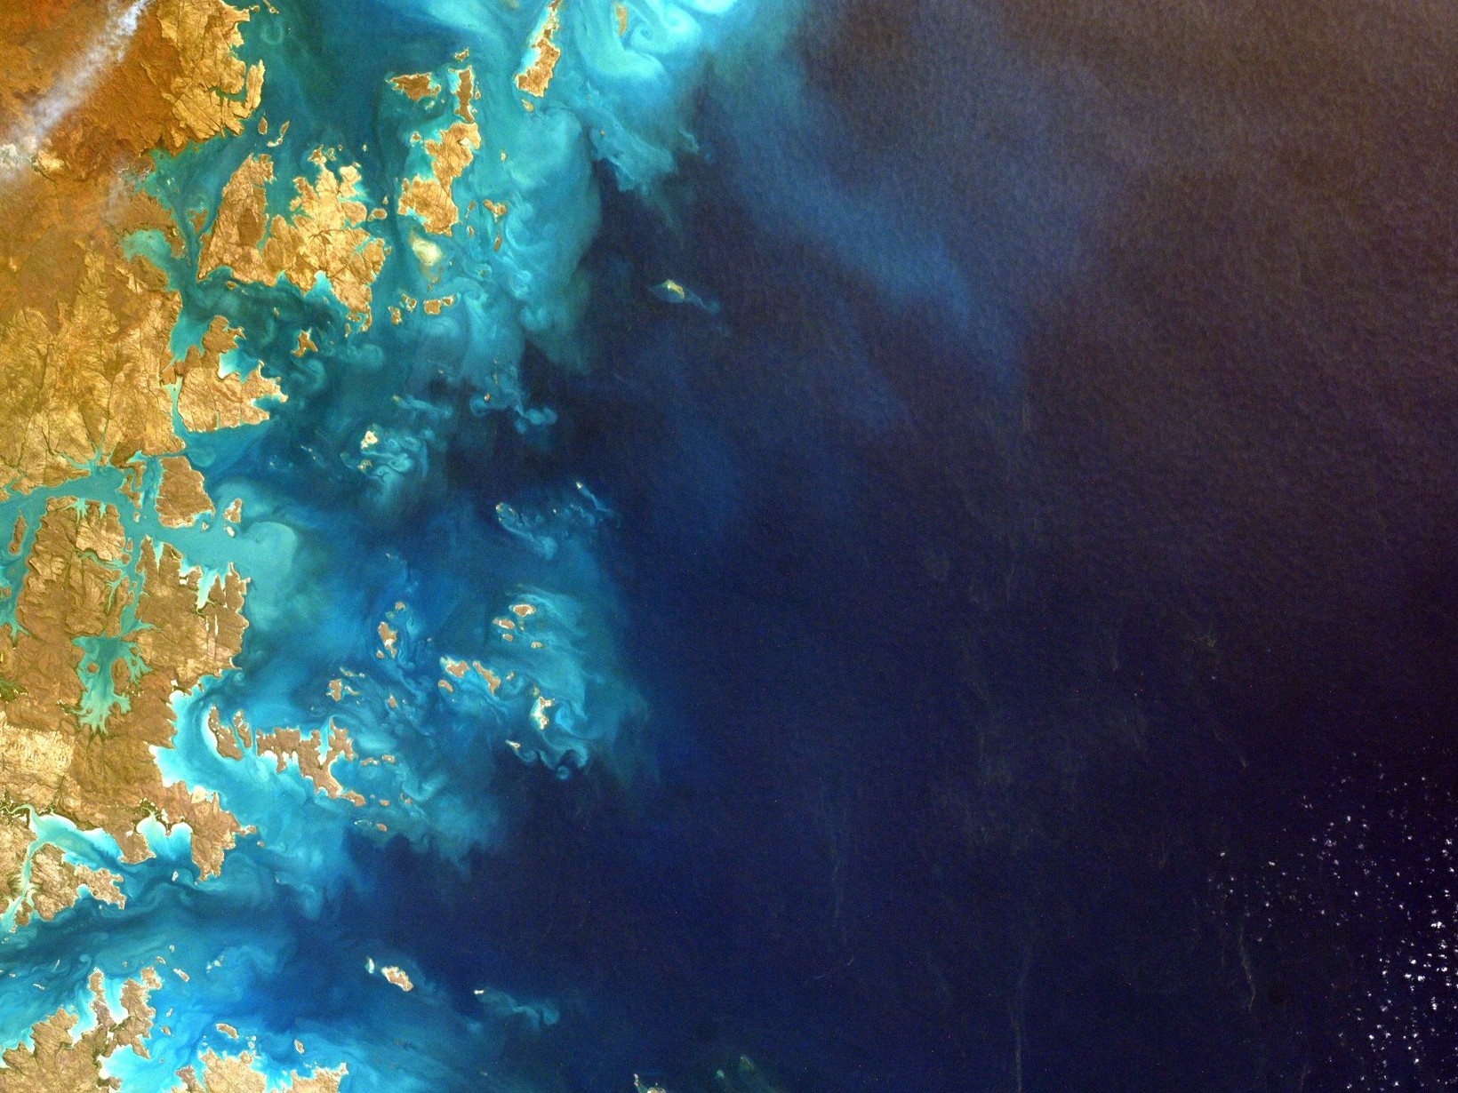

An Australian alternative
to choropleth maps; visualising geo-spatial
disease data
Stephanie Kobakian
School of Mathematical Sciences: Science and Engineering Faculty
slides: srkobakian-qut.netlify.com/

Slide 2
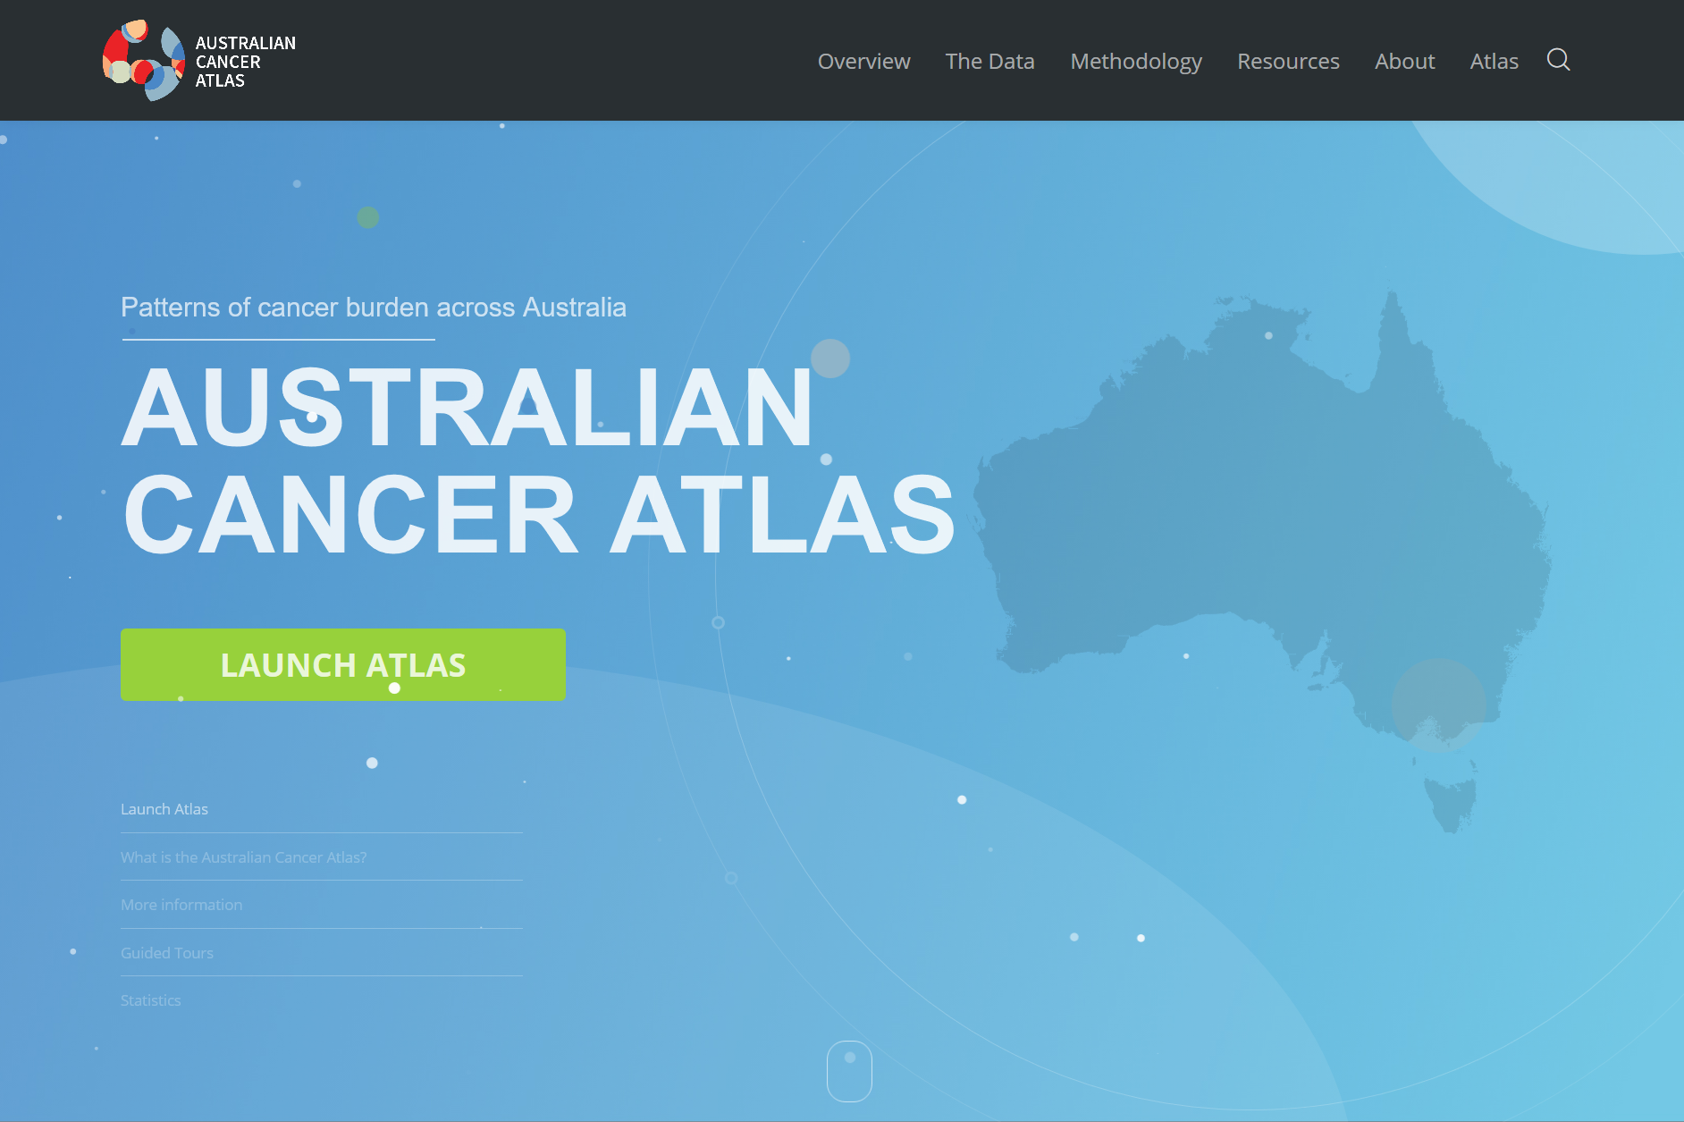
Australian Cancer Atlas
slides: srkobakian-qut.netlify.com/

Slide 3
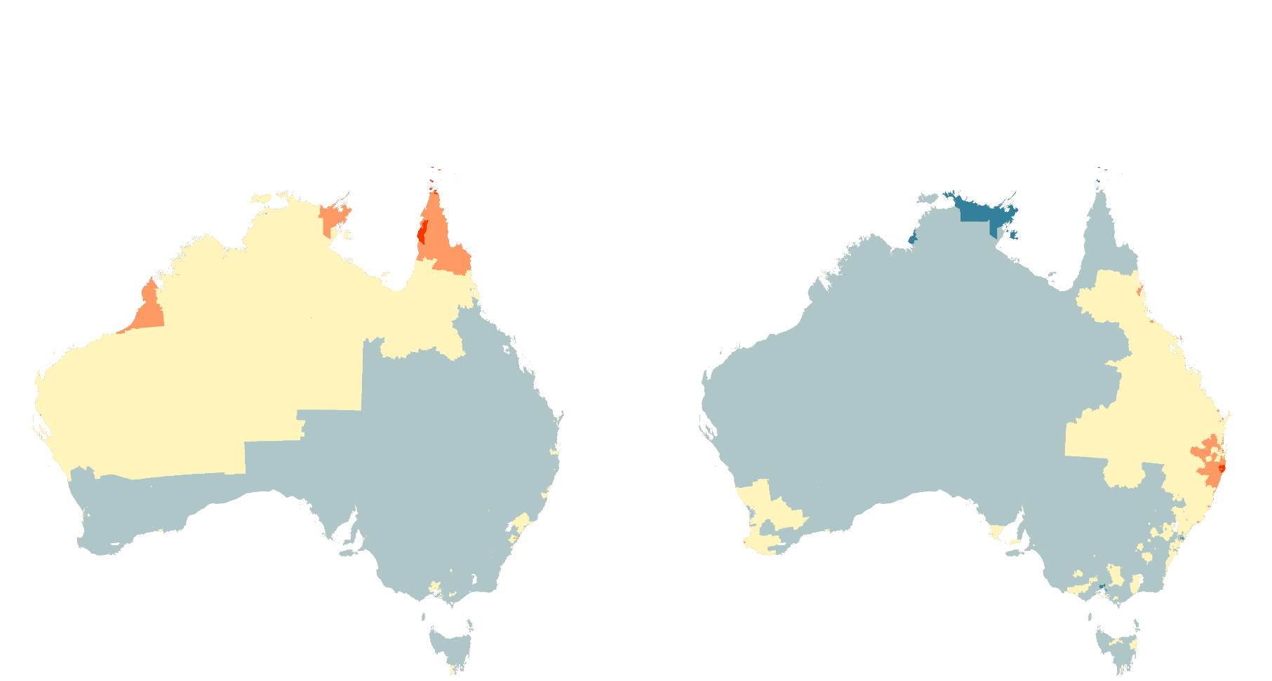
Liver: Red and orange areas in North Queensland
Liver: Most of the South East is blue Melanoma: Red and orange areas around Brisbane
Melanoma: Most of the country is blue, except Queensland

Slide 4
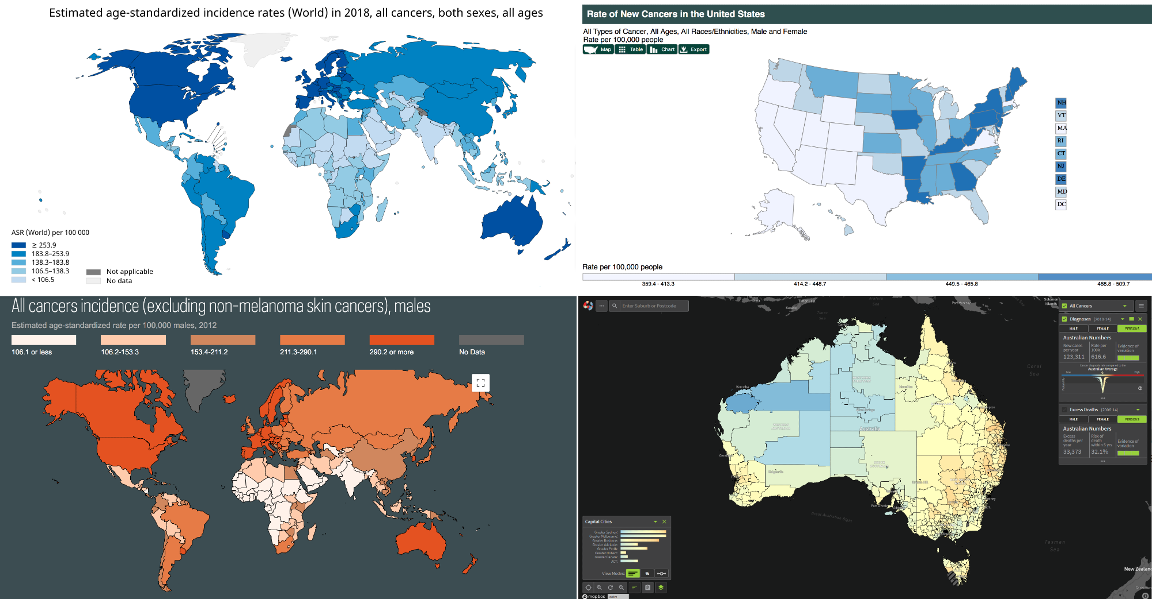
Global Atlases
slides: srkobakian-qut.netlify.com/

Slide 5
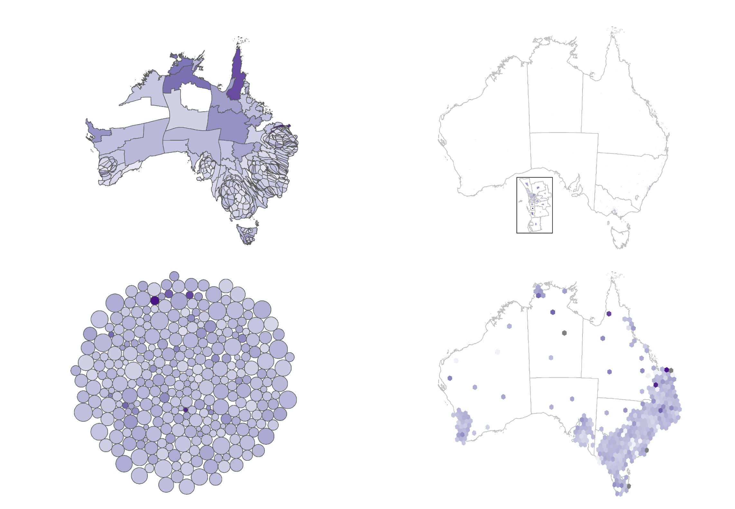
Alternative displays of Australia

Slide 6
Aims
1: Hexagon tile maps: an algorithm
2: Animation: connecting the choropleth and hexagon tile maps
3: Test the effectiveness: understanding the hexagon tile map in action

Slide 7
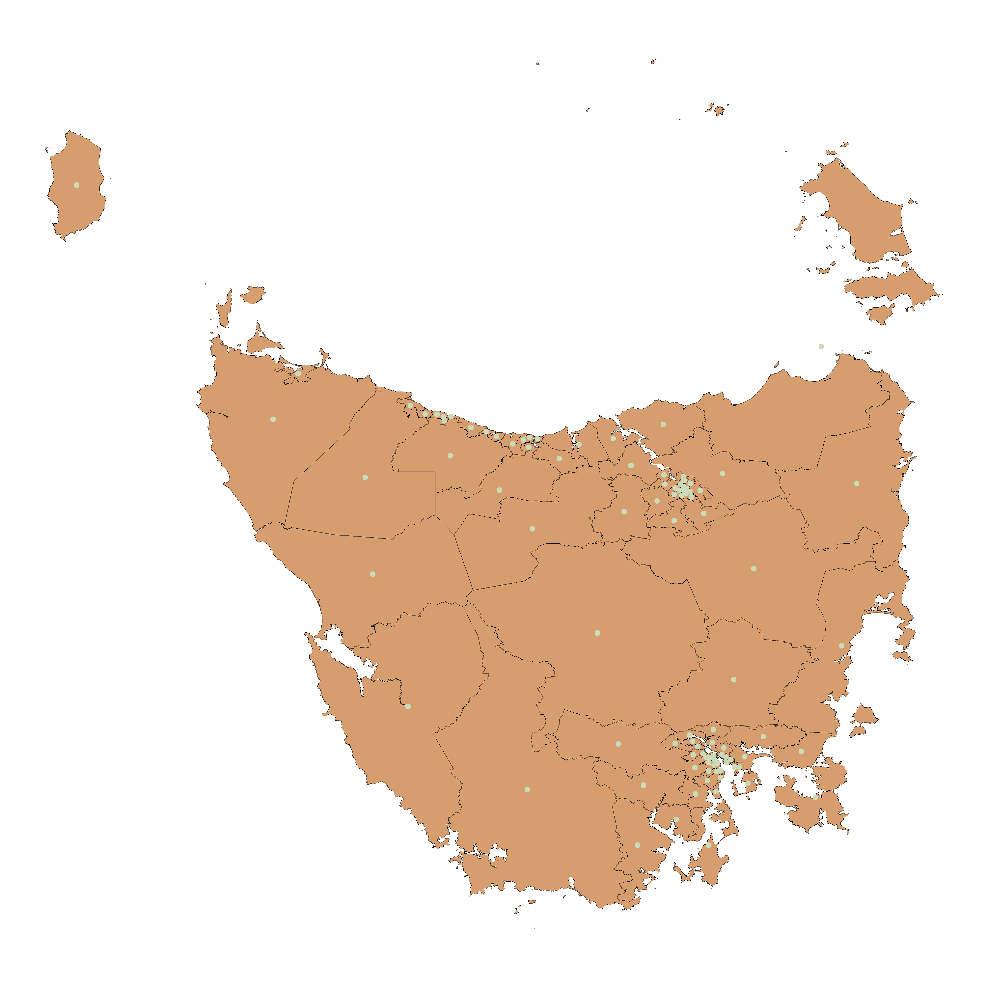
Tasmania: 98 SA2 regions
What is this choropleth map lacking?
slides: srkobakian-qut.netlify.com/

Slide 8
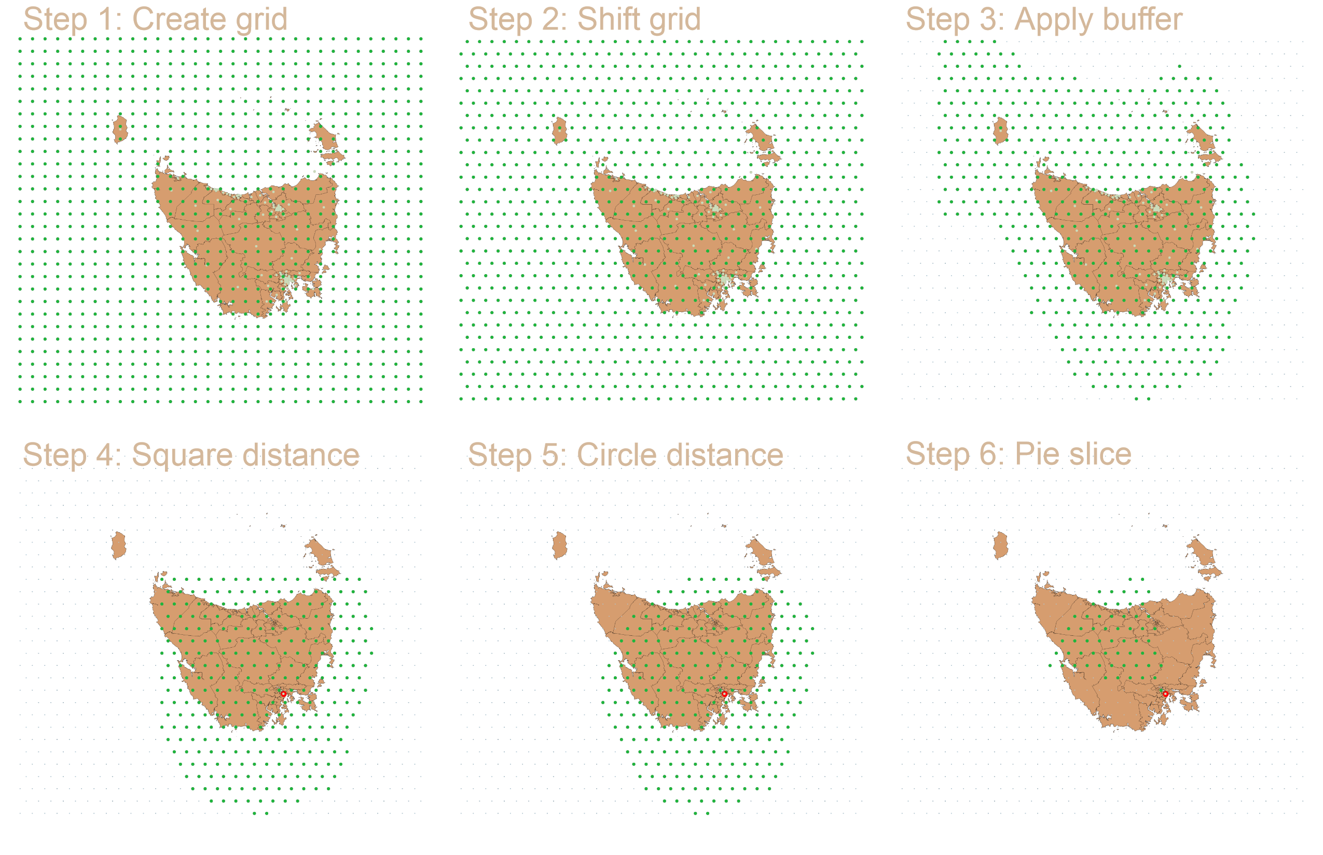
Choosing a hexagon
slides: srkobakian-qut.netlify.com/

Slide 9
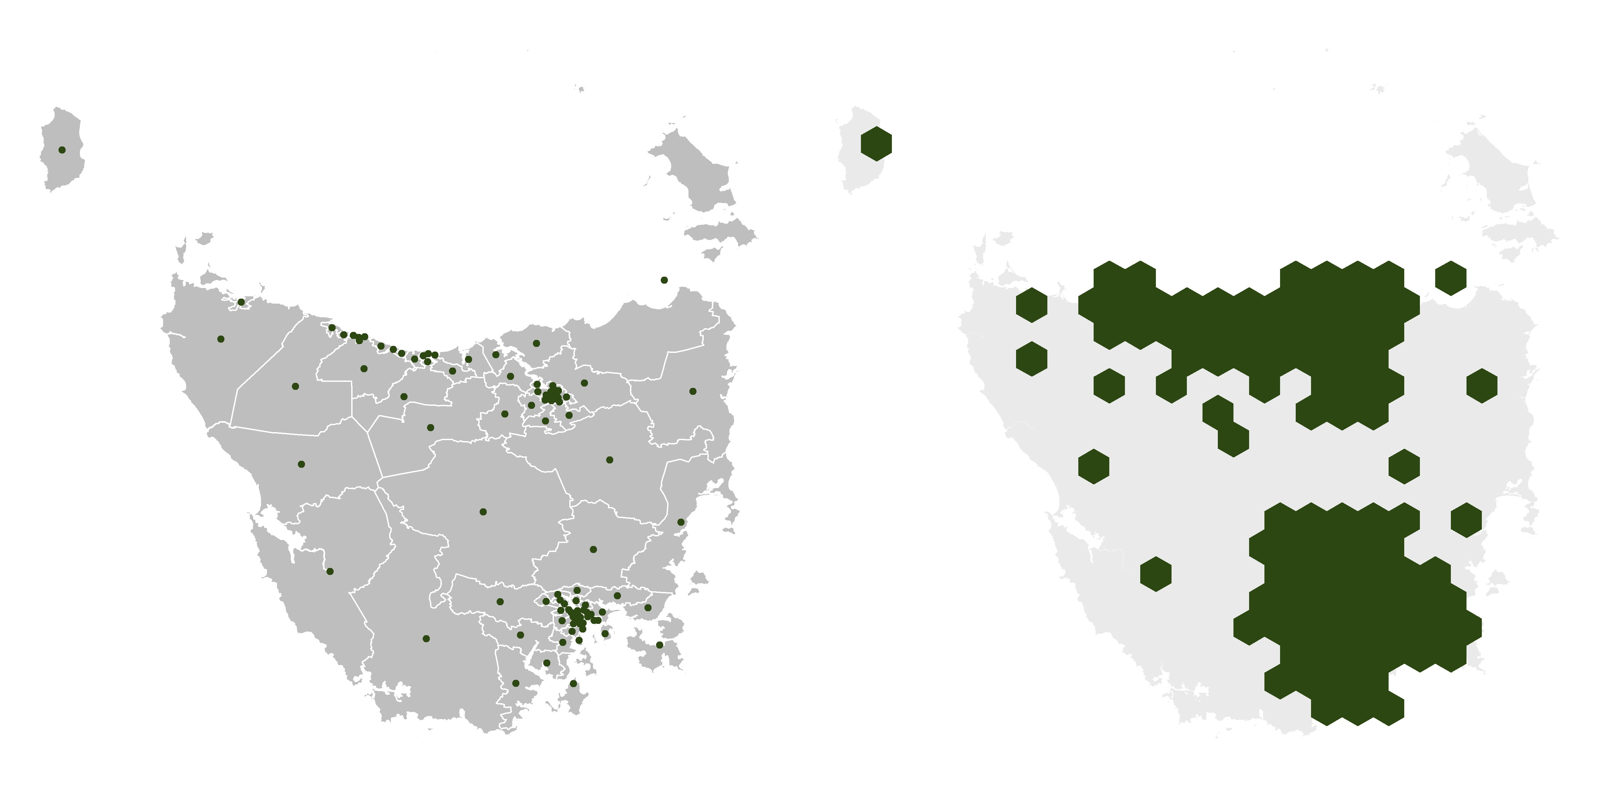
Final product
slides: srkobakian-qut.netlify.com/

Slide 10
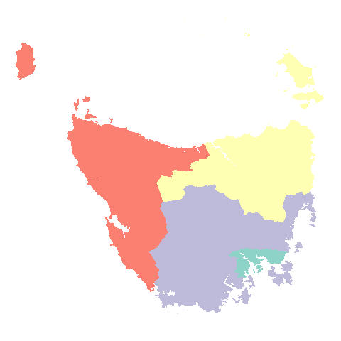
Animating
animation: srkobakian-qut.netlify.com/tasanim.gif

Slide 11

Animating
animation: srkobakian-qut.netlify.com/tasanim.gif

Slide 12
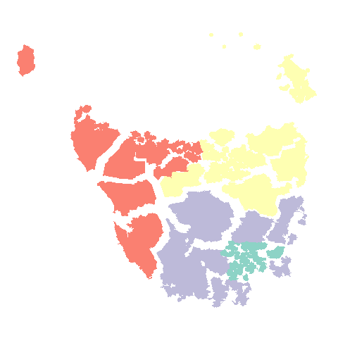
Animating
animation: srkobakian-qut.netlify.com/tasanim.gif

Slide 13
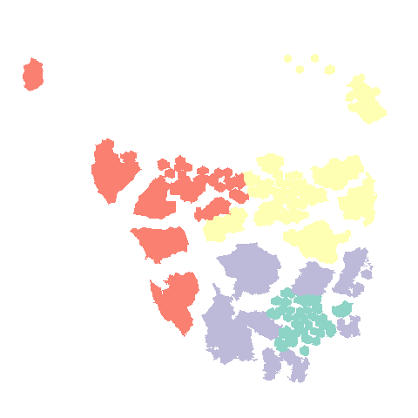
Animating
animation: srkobakian-qut.netlify.com/tasanim.gif

Slide 14
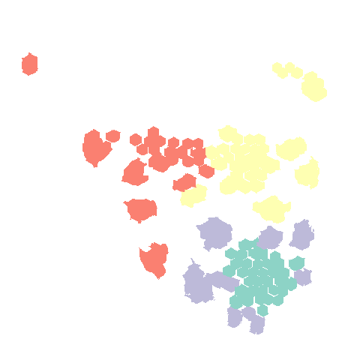
Animating
animation: srkobakian-qut.netlify.com/tasanim.gif

Slide 15
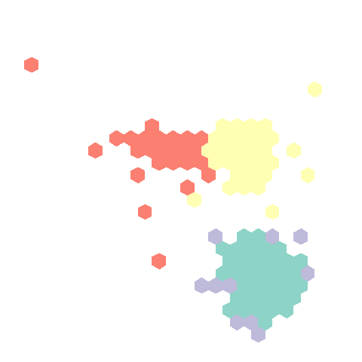
Animating
animation: srkobakian-qut.netlify.com/tasanim.gif

Slide 16
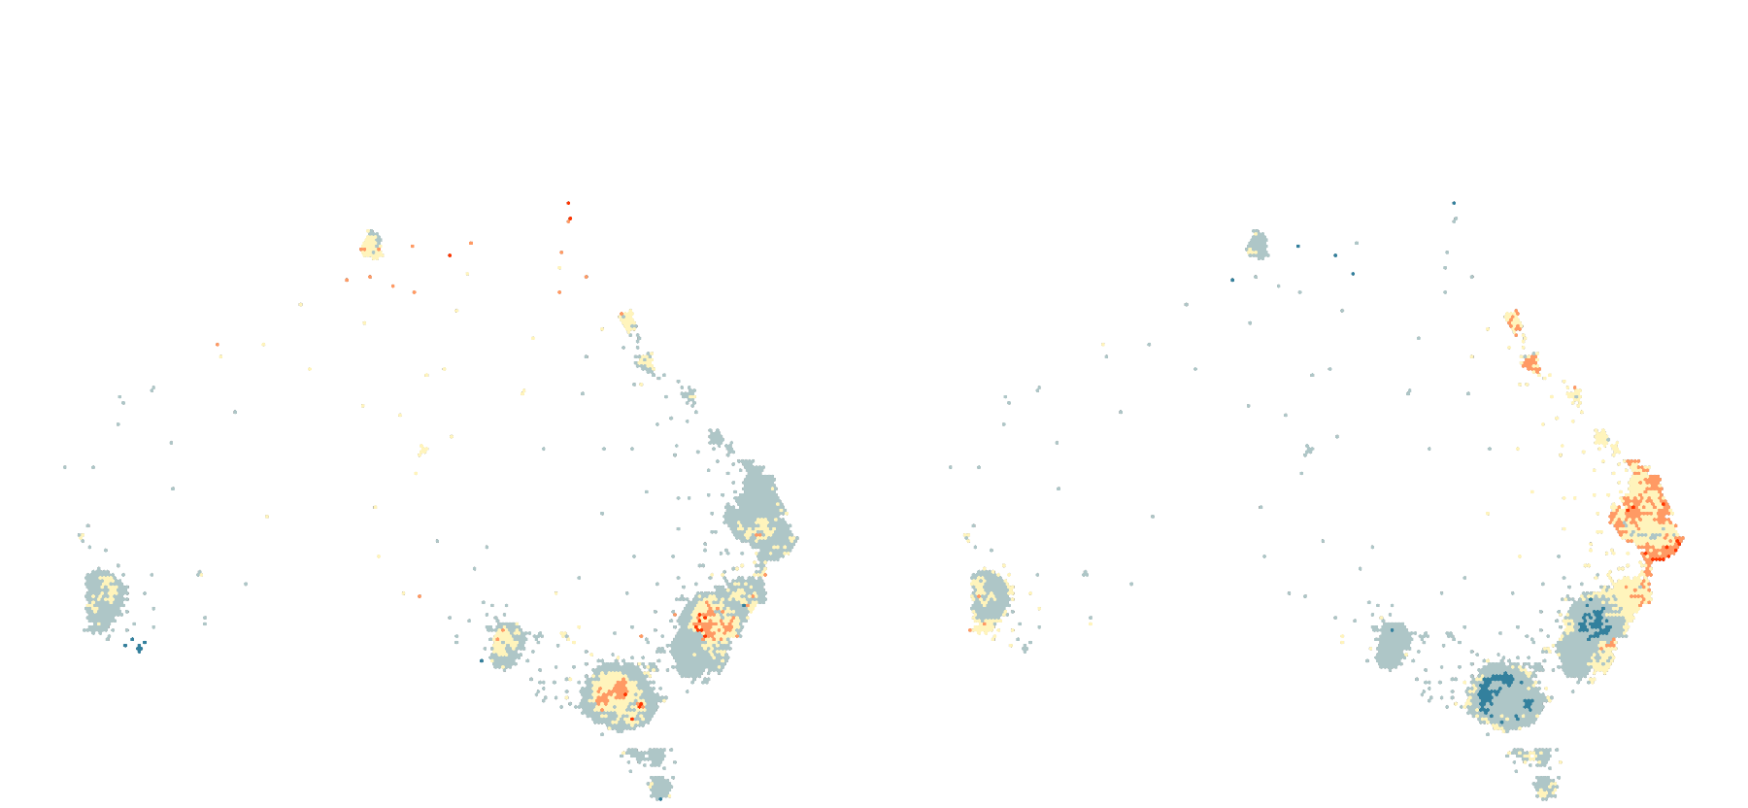
Liver: Red and orange areas in North Queensland, Melbourne, Sydney
Liver: Most of the South East is blue, city areas are yellow
Melanoma: Red and orange areas around Queensland cities and Brisbane, not in CBD Melanoma: Most of the other areas are blue

Slide 17
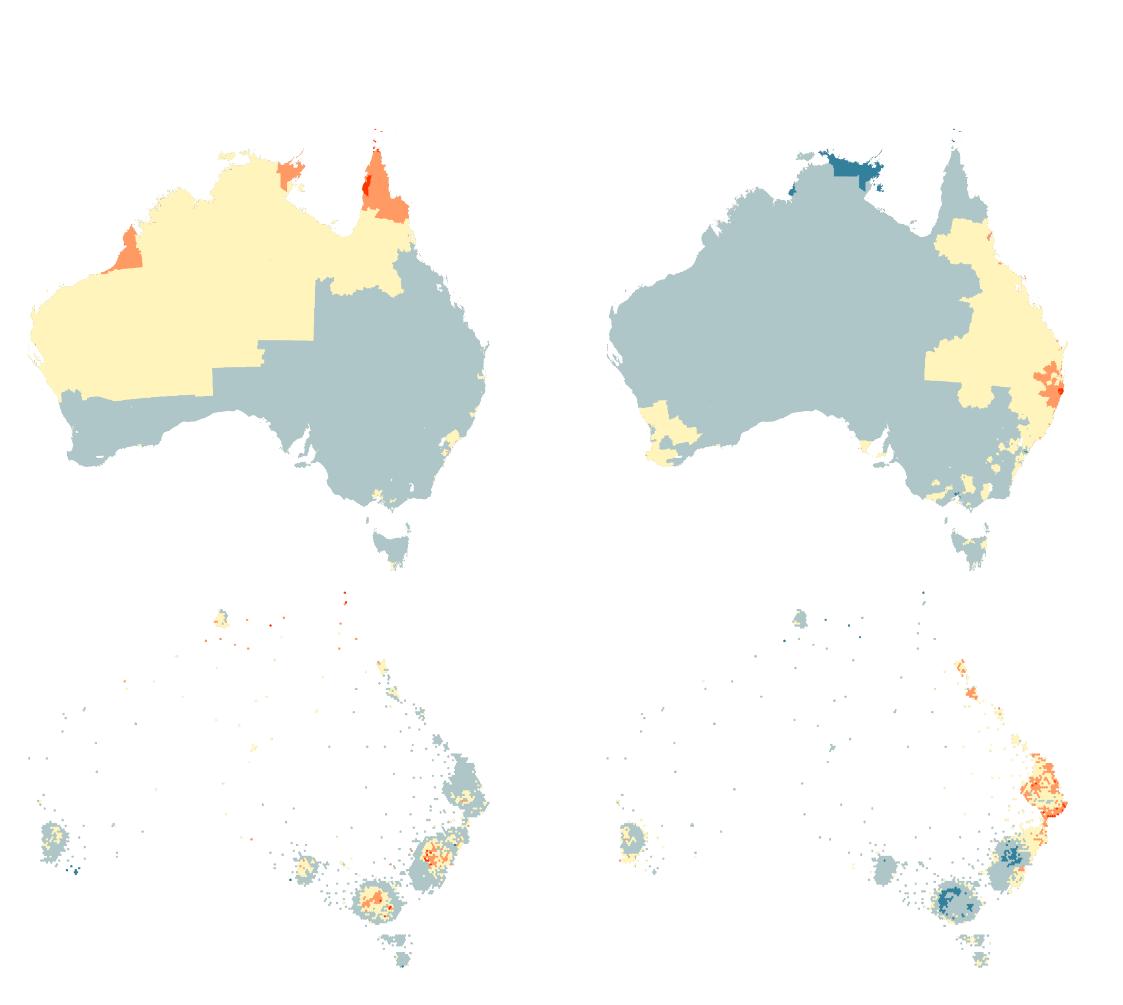
What can we learn?
slides: srkobakian-qut.netlify.com/

Slide 18
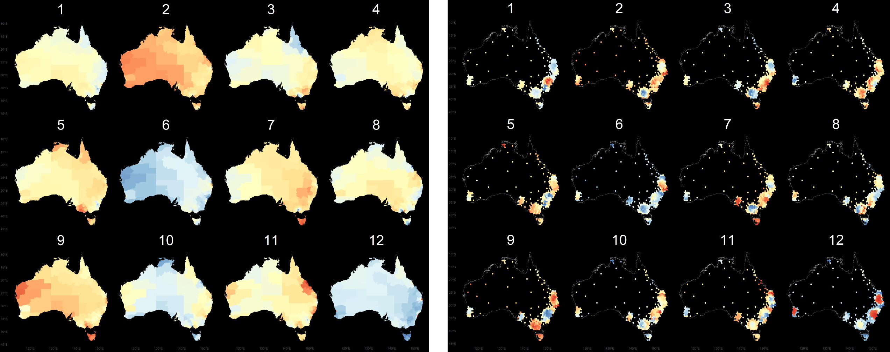
Line up experiment
Same data, different display
slides: srkobakian-qut.netlify.com/

Slide 19
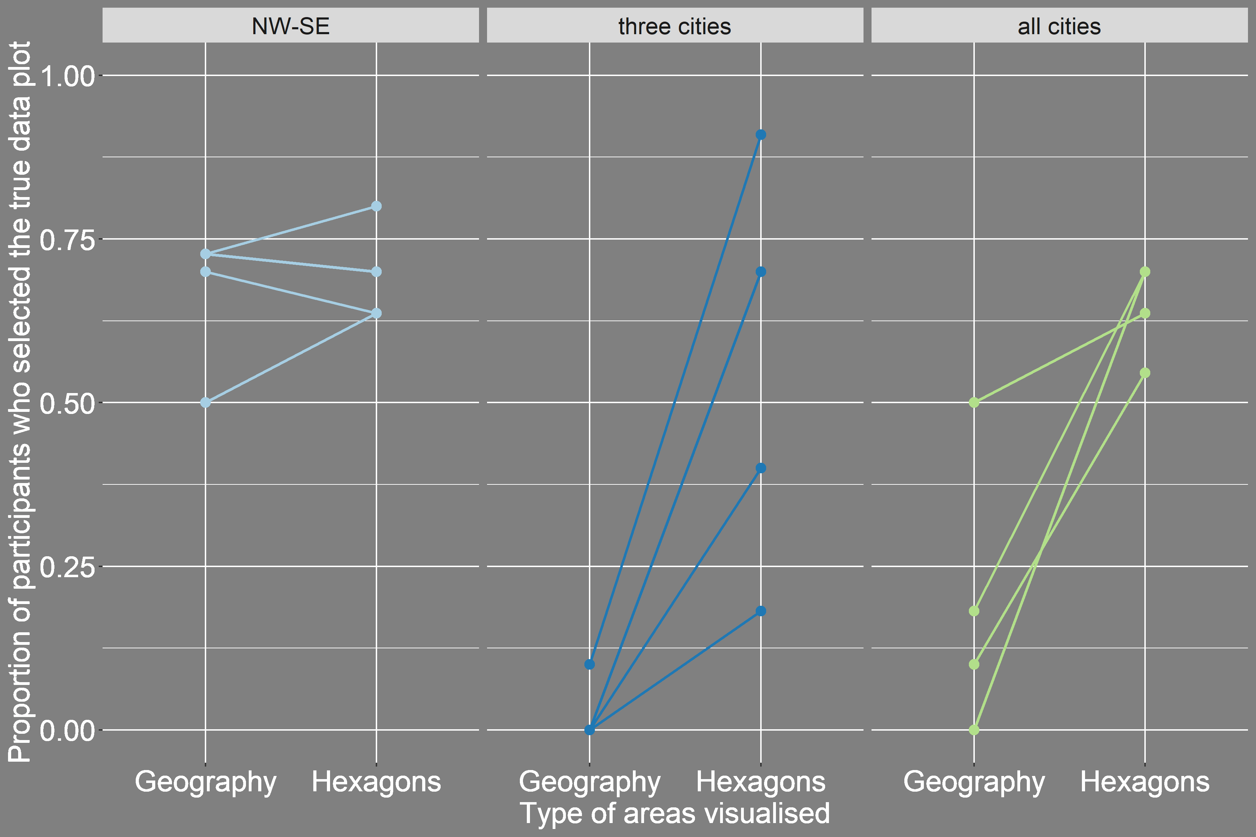
Probability of detection
slides: srkobakian-qut.netlify.com/

Slide 20
References
Dougenik JA, Chrisman NR, Niemeyer DR. An Algorithm to Construct Continuous Area Cartograms. The Professional Geographer 1985;37:75–81. doi:10.1111/j.0033- 0124.1985.00075.x.
Olson JM. Noncontiguous Area Cartograms. The Professional Geographer
1976;28:371–80. doi:10.1111/j.0033-0124.1976.00371.x.
Dorling D. Area Cartograms: Their Use and Creation. In:. Concepts and techniques in modern geography (catmog), vol. 59, 2011, pp. 252–60. doi:10.1002/9780470979587.ch33.
Buja, A., D. Cook, and D. Swayne. (1999). “Inference for Data Visualization.” In Talk
given at Joint Statistical Meetings. Baltimore, Maryland. Accessed 11 November 2019 from http://www-stat.wharton.upenn.edu/~buja/PAPERS/visual-inference.pdf.
Pebesma, E., 2018. Simple Features for R: Standardized Support for Spatial Vector
Data. The R Journal 10 (1), 439-446, https://doi.org/10.32614/RJ-2018-009
H. Wickham. ggplot2: Elegant Graphics for Data Analysis. Springer-Verlag New York, 2016.
Hadley Wickham (2017). tidyverse: Easily Install and Load the 'Tidyverse'. R package
version 1.2.1. https://CRAN.R-project.org/package=tidyverse
JJ Allaire and Yihui Xie and Jonathan McPherson and Javier Luraschi and Kevin Ushey and Aron Atkins and Hadley Wickham and Joe Cheng and Winston Chang and Richard Iannone (2019). rmarkdown: Dynamic Documents for R. R package version
1.16. URL https://rmarkdown.rstudio.com.
9. Stephanie Kobakian and Dianne Cook (2019). sugarbag: Create Tessellated Hexagon Maps. R package version 0.1.1. https://CRAN.R-project.org/package=sugarbag
slides: srkobakian-qut.netlify.com/

Slide 21

Thank you!
DProf. Kerrie Mengersen, Dr Earl Duncan, Prof. Di Cook
created with xaringan 
scripts and data available  srkobakian
title slide image NASA/EarthKAM
This work is under licensed  BY-NC 4.0.

